Slide 1
House price prediction ML Project

Slide 2
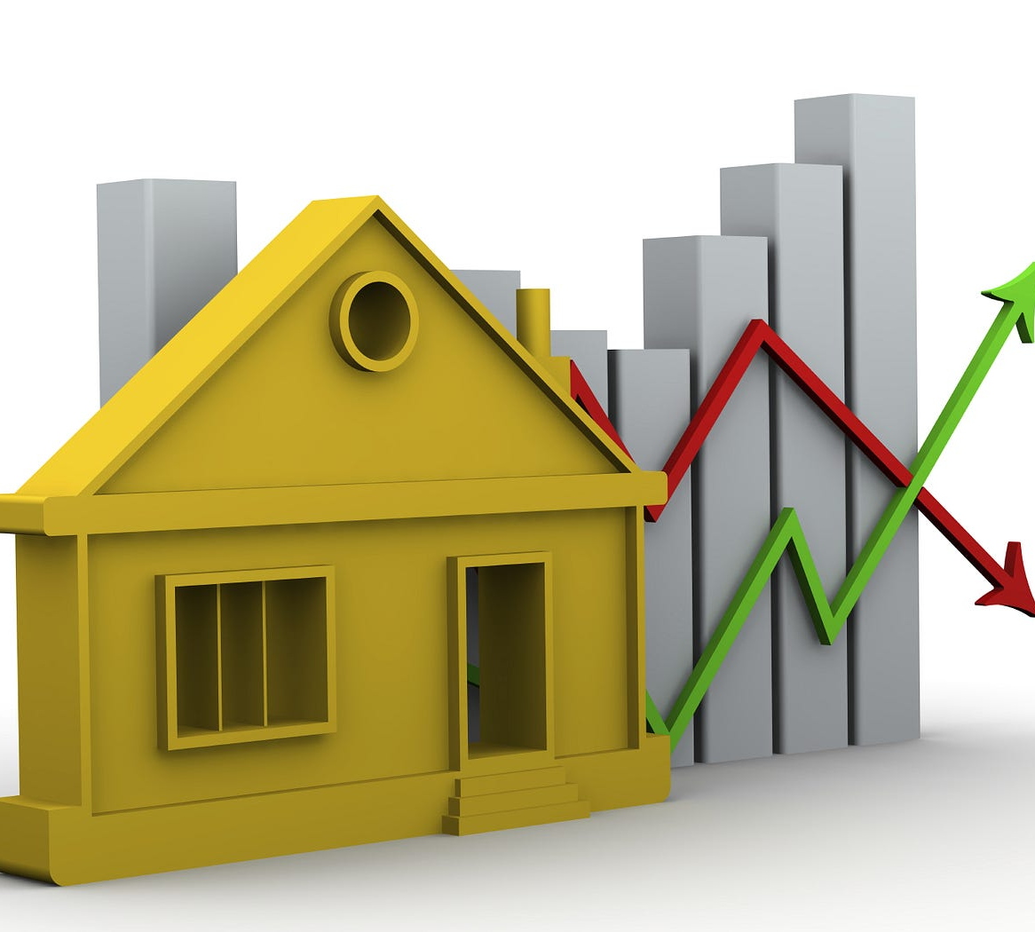
Agenda
House Price Prediction
The main aim of this project is to train the data set which contains various factors of comparison to make predictions over the price of the house.

Slide 3
Contents:
Project Intro
Tools Used
Packages Used
Procedure Followed
Outcomes

Slide 4
Project Intro
This project involves with making predictions on a data set named with house price predictions. The dataset is available at the below link:
https://media.geeksforgeeks.org/wp-content/uploads/20240905183434/HousePricePrediction.xlsx
Our project is a machine learning project, based on certain specifications of future home it will try to guess the more accurate price. Information such as lot size, year built, sale price, overall condition of the house and many other attributes are considered.

Slide 5

Tools used
Different tools which are used while working with this project are:
Python
Anaconda
Jupyter notebook
The above are the popular tools which are used when working with any data science project as a user friendly platforms.

Slide 6
Packages used
Pandas:
Pandas is a Python library used for working with data sets. It has functions for analyzing, cleaning, exploring, and manipulating data.
Various functions and methods involved are:
read_csv : To read i.e., to load csv format files into the tool.
isnull: A dataframe method of pandas which returns true if there locates an na or null value in the column.
dropna : To drop the rows containing the na or null values.
These are few of them which are used in our project.
Pandas
Matplotlib
Seaborn
Sklearn
Catboost

Slide 7
Matplotlib:
Matplotlib is a powerful plotting library in Python used for creating static, animated, and interactive visualizations. We will be using pyplot which is the submodule of matplotlib.
It’s primary purpose is to provide users with the tools and functionality to represent data graphically, making it easier to analyze and understand.
Example.,.
plot(x, y): It plots the data with x and y coordinates.
title: For providing the title for the given plot.
etc.,.
Seaborn:
Seaborn is a library for creating statistical graphics in Python. It is based on Matplotlib and integrates with Pandas data structures.
This library is as powerful as Matplotlib but brings simplicity and unique features. It allows for quick data exploration and understanding.
Example.,.
Heatmap
Barplot

Slide 8
Seaborn:
Scikit-learn is probably the most useful library for machine learning in Python. The sklearn library contains a lot of efficient tools for machine learning and statistical modeling including classification, regression, clustering and dimensionality reduction.
Scikit-Learn, also known as sklearn.
Example.,.
LinearRegression: Linear regression is the process of determining the straight line that best fits a set of data points. The line can then be projected to forecast fresh data points.
RandomForestRegressor: A random forest is a meta estimator that fits a number of decision tree regressors on various sub-samples of the dataset and uses averaging to improve the predictive accuracy.
Catboost:
Catboost is a high-performance gradient-boosting technique made for machine learning tasks, especially in situations involving structured input. Catboost uses a method termed “ordered boosting” to process categorical data directly, resulting in faster training and better model performance.
We will use this dataset to perform a regression task using the catboost algorithm.

Slide 9
Procedure
Import Libraries
Reading the dataset
This is the flow of process which is involved in the working and the completion of the project.
Understanding the dataset
Formulating the training and the testing data
Identifying the best regression algorithm
Making Predictions

Slide 10
About the dataset:
The dataset of house price prediction contains about 2919 rows and 13 columns.
The attributes or the columns involved are as follows:
MSSubClass: The building class.
MSZoning: The general zoning classification.
LotArea: Lot size in square feet.
LotConfig: Configuration of the lot.
BldgType: Type of dwelling.
OverallCond: Rates the overall condition of the house.
YearBuilt: Original construction year.
YearRemodAdd: Remodel date (same as construction date if no remodeling or additions).
Exterior1st: Exterior covering on house.
BsmtFinSF2: Type 2 finished square feet.
TotalBsmtSF: Total square feet of basement area.
SalePrice: To be predicted.

Slide 11
Outcomes:
The final outcome of the project resides with predicting the sale price of a houses given in the testing data.
It also has the capability of [predicting for an unseen data considered by providing the required parameters.
Finally we used SVM and the catboost to predict the values.
House price prediction using machine learning can help many stakeholders make informed decisions and it also helps
Homebuyers and sellers.
Real estate agents and investors.
Policymakers

Slide 12
Thank you
J D S S Chandra Pavana Sree
III Data Science

